Slide 1
DTV Receiver – Software Architecture

Slide 2
Topics
Software Architecture of DTV Receiver
Middleware
SI Parser
Database
Teletext
Subtitle
EPG
UI Framework

Slide 3
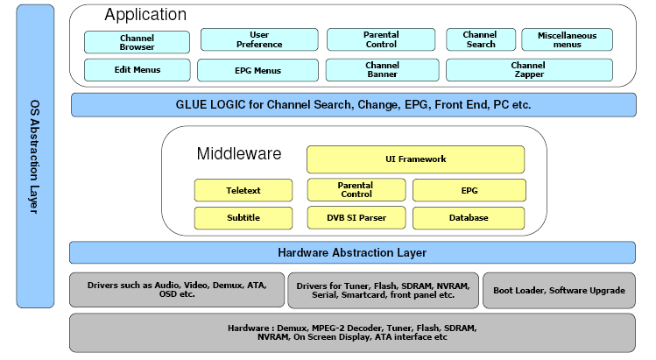
Software Architecture of DTV

Slide 4
Middleware
DTV Middleware provides a common software platform for application development
It is usually a C or Java code
Every middleware platform has basically the same features
e,g. Graphics & video manipulation, return channel access, access to service information, etc.
Various modules of DTV Middleware are:
SI Parser
Service Database
Tele text
Subtitles
EPG
Parental Control
UI Framework

Slide 5
SI Parser
SI (Service Information) Parser
SI is responsible for collecting MPEG,DVB tables and Parsing
SI is also responsible for parsing all the descriptors
Updates database with service and events information
Monitor the version change
Generally SI parser module is divided as
SI Capture
SI Parser
Service Database
Used for storing service and tuning information
Interfaces to be provided to application such as add, delete, move, sort, store, reload etc
Common database interface API’s for accessing service data from the different database

Slide 6
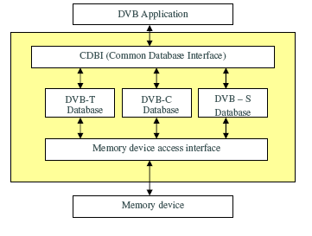
Database
Used for storing service and tuning information
Interfaces to be provided to application such as add, delete, move, sort, store, reload etc
Common database interface API’s for accessing service data from the different databases
Pan-European requirements
Service Replacement
Logical Channel Number
Parental Control
Duplicate Service

Slide 7
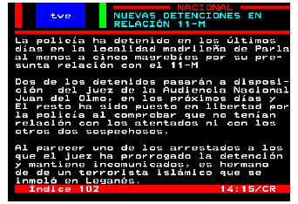
Teletext
Teletext provides public information such as
Local Weather
Sports News
Train Timings
Stock Exchange etc
Teletext is organized as magazines and pages
Users can navigate through either through embedded links of by page numbers directly.
Teletext Service is carried in a separate PID and is broadcast periodically
Typically these pages are cached in memory for faster access

Slide 8
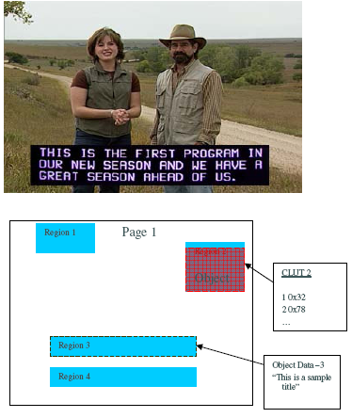
Subtitle
Subtitle is a visual representation of speech (audio)
For Languages other than transmitted audio
For hearing impaired persons
Subtitles are transmitted as
Text
Graphics
Subtitles are of 2 types
Open - Part of video
Closed – Can be hidden
Subtitles comes as PES packets in a separate PID

Slide 9
Subtitle (contd)
They need to extracted, decoded and overlaid on video.
Graphics Subtitles are RLE (Run Length Encoding) encoded
Indexed Formats are used
Overlays can timeout
Subtitles are synched with the video based on their presentation time stamps
Subtitles are organized hierarchically
Page – Entire Canvas
Regions - Rectangular
Objects

Slide 10
Electronic Program Guide
EPG is a electronic equivalent of TV events page in newspaper
EPG provide detail information about the event schedule such as start time, duration, rating etc.
Events are classified in different categories such as Sports, Movies, News, etc
EPG also provides short and long description about the event
EIT Present/Following table will carry current/next event information
EIT0-15 tables will carry schedule event information
EPG database for maintaining all the event information

Slide 11
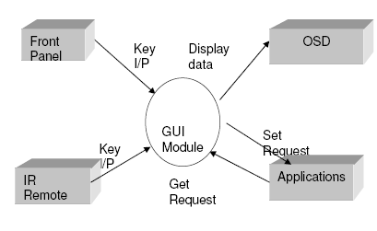
UI Framework
GUI Framework will have common logic used by applications
Provide controls such as list, button etc
Provide region management such creation, deletion etc
Provide support for palette, Bitmap display, drawing routine etc.
Provide support for color conversion routines
Provide fonts support
Support for compression for icons and bitmaps

Slide 12
Thank you

Slide 13


